Slide 1
Innovations Methods and Frameworks

Slide 2

Innovation
Innovation is commonly defined as the "carrying out of new combinations" that include "the introduction of new goods, ... new methods of production, ... the opening of new markets, ... the conquest of new sources of supply ... and the carrying out of a new organization of any industry"
However, many scholars and governmental organizations has given their own definition of the concept.
Some common element in the different definitions is a focus on newness, improvement and spread.

Slide 3
Innovation
An innovation is something original and more effective and, as a consequence, new, that "breaks into" the market or society.
Innovation is related to, but not the same as, invention: innovation is more apt to involve the practical implementation of an invention to make a meaningful impact in a market or society, and not all innovations require a new invention.
Technical Innovation often manifests itself via the engineering process when the problem being solved is of a technical or scientific nature.
It is not possible to innovate without a HCD approach! a product or service in order to be innovative must be usable!

Slide 4


Sustaining innovation
Most of the innovation processes are based on incremental innovation. Minor improvements of existing products.
step by step process
low risk
low speed
no changes to company organization required
no user re-skilling required
low probability to change/scale-up the business
target user and market sector stable

Slide 5
Disruptive Innovation
A disruptive innovation is an innovation that creates a new market and value network and eventually disrupts an existing market and value network, displacing established market-leading firms, products, and alliances.
The term was defined and first analyzed by the American scholar Clayton M. Christensen and his collaborators beginning in 1995, and has been called the most influential business idea of the early 21st century.
The term is now generalized to identify disruptive science and technological advances.

Slide 6
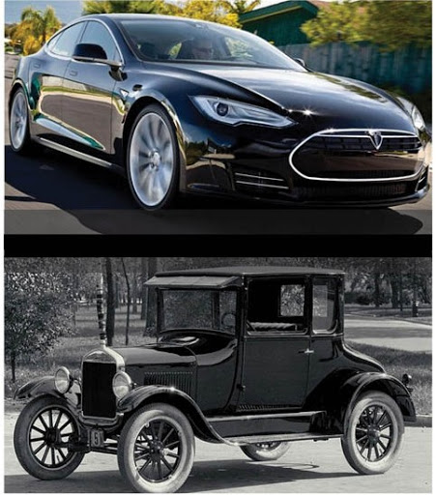
Disruptive Innovation
Not all innovations are disruptive, even if they are revolutionary.
For example, the first automobiles in the late 19th century were not a disruptive innovation, because early automobiles were expensive luxury items that did not disrupt the market for horse-drawn vehicles. The market for transportation essentially remained intact until the debut of the lower-priced Ford Model T in 1908. The mass-produced automobile was a disruptive innovation, because it changed the transportation market, whereas the first thirty years of automobiles did not.

Slide 7
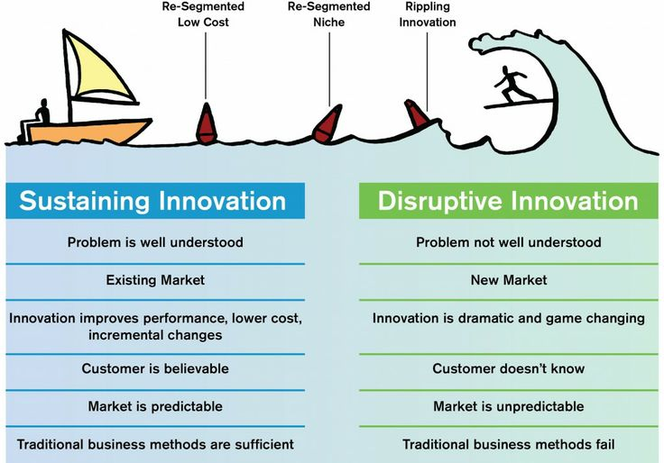
https://hcldr.wordpress.com/2017/01/10/disruptive-innovation-in-healthcare/

Slide 8
Disruptive Innovation and Human Centered Design
Disruptive innovation must be user centered!
No users no innovation!

Slide 9
Human Centered Design
Human-centred design is an approach to interactive systems development that aims to make systems usable and useful by focusing on the users, their needs and requirements, and by applying human factors/ergonomics, usability knowledge, and techniques.
This approach enhances effectiveness and efficiency, improves human well-being, user satisfaction, accessibility and sustainability; and counteracts possible adverse effects of use on human health, safety and performance.
ISO 9241-210:2010(E)

Slide 10
Product Management Vs Product Development
product management is about the what, while product development is more concerned with the how. Working alongside each other, product managers and product development teams create the ideal product.
The product development team takes the requirements specified by the product manager and fashions them into a working product that meets the organization’s quality standards.
Product development, is the process of getting an idea from concept to market. Product development teams can consist of software developers, designers, engineers, quality assurance testers — anything it takes to bring the ideal product to life.

Slide 11
Methods and Frameworks for Disruptive Innovation

Slide 12
Human Centered Design Process

Slide 13
Human Centered Design Process
IDEO is one of the most innovative and award-winning design firms in the world.
IDEO’s main tenet is empathy for the end-user of their products. They believe that the key to figuring out what humans really want lies in doing two things:
Observing user behavior: Try to understand people by observing them. For example, if you’re designing a vacuum cleaner, watch people vacuum.
Putting yourself in the situation of the end-user: IDEO does this to understand what the user experience is really like; to feel what their users feel.
Then, they use the information they gain to fuel their designs.

Slide 14
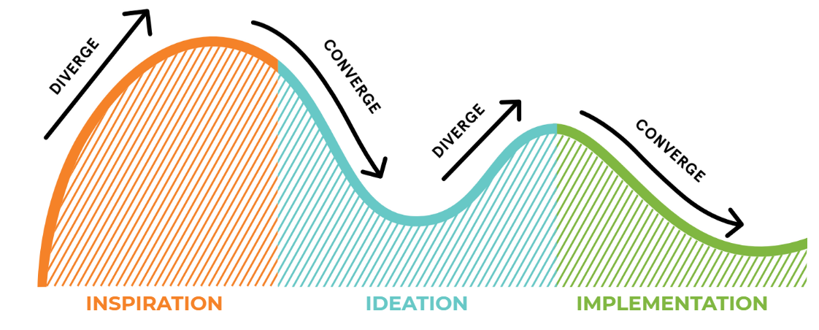
Human Centered Design Process
IDEO defines the human centered design process as a creative approach to problem-solving that starts with people and ends with innovative solutions that are tailor-made to suit their needs.
VIDEO https://vimeo.com/106505300
https://blog.movingworlds.org/human-centered-design-vs-design-thinking-how-theyre-different-and-how-to-use-them-together-to-create-lasting-change/

Slide 15
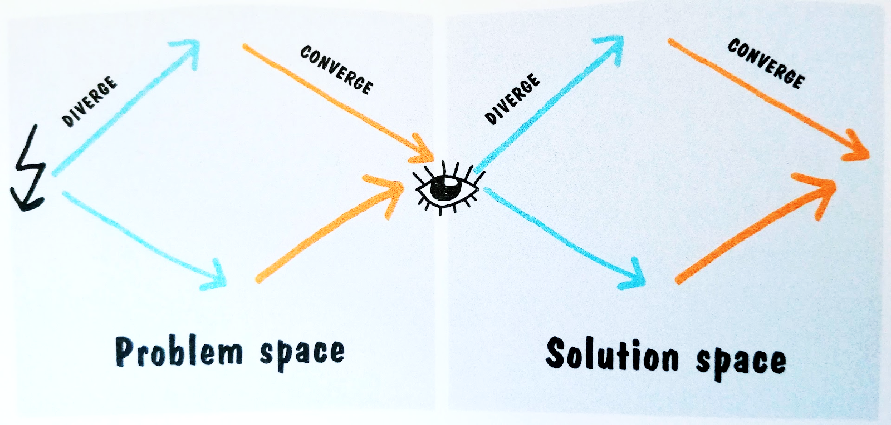

Slide 16
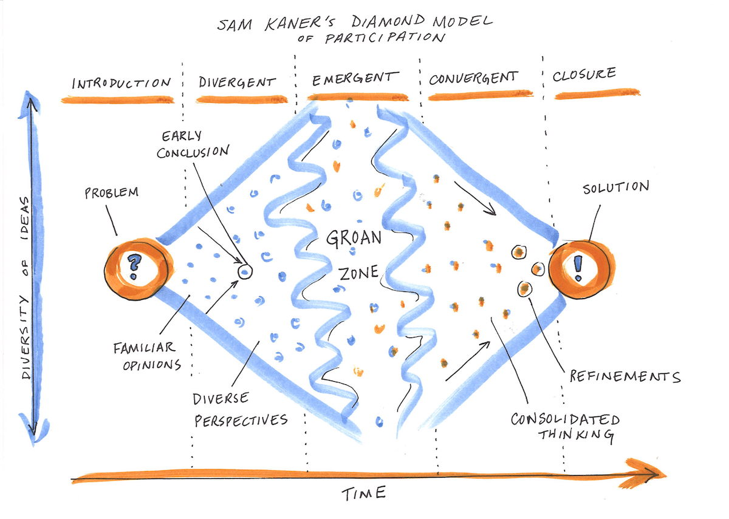
image source

Slide 17
Solution
Prototype
image source

Slide 18
Human Centered Design Process
Inspiration: The inspiration phase is all about understanding your user’s needs and challenges, and dropping any preconceived notions you might have about them. At this stage in the HCD process you need to remove any specific outcomes in mind, and instead open yourself to a wide variety of possible solutions.
Ideation: After consolidating your research and findings, this phase is about visualizing, retargeting, brainstorming and discussing all the potential solutions. Penning down your ideas in front of you - regardless of how flawed or impractical - helps you and your end-user hone in on what’s going to work and what’s not. At this stage, you don’t want to start off with expensive prototypes - all you need are some basic sketches, lists or small scale models to tap into your creativity without the pressure to produce a polished final product. What’s important about this phase is that once you’ve gotten feedback early, you can reiterate your best ideas until you’ve made your way to a well-developed concept that works for everyone, and is aimed at impacting your user in a positive way.
Implementation: The first two phases were meant to set the ground for you and your team to find a concept that feels right, before moving forward and setting aside money to build and run rapid prototypes. In this phase, this contains the tail end of the pre-production phase, where a high fidelity prototype is put together for your users to try out, as well as the actual production of the object (or coding, for web and app-based projects). This is a good time to create a business model around the concept, make necessary partnerships and prepare your product for real-world use.

Slide 19
Design Thinking

Slide 20
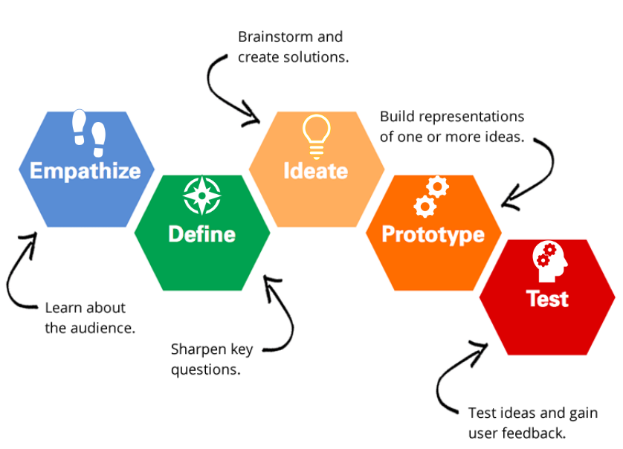
Design Thinking
Popularized by Stanford’s d.school, is a process that you go through to create solutions that will actually be adopted by people.
https://blog.movingworlds.org/human-centered-design-vs-design-thinking-how-theyre-different-and-how-to-use-them-together-to-create-lasting-change/

Slide 21
Design Thinking
Design Thinking is an iterative process in which we seek to understand the user, challenge assumptions, and redefine problems in an attempt to identify alternative strategies and solutions that might not be instantly apparent with our initial level of understanding.
At the same time, Design Thinking provides a solution-based approach to solving problems.
It is a way of thinking and working as well as a collection of hands-on methods.

Slide 22
Design Thinking
Design Thinking is extremely useful in tackling problems that are ill-defined or unknown, by re-framing the problem in human-centric ways, creating many ideas in brainstorming sessions, and adopting a hands-on approach in prototyping and testing.
Design Thinking also involves ongoing experimentation: sketching, prototyping, testing, and trying out concepts and ideas.

Slide 23
Design Thinking
5 phases:
Empathise: study your users
Define your users’ needs, their problem, and your insights
Ideate by challenging assumptions and creating ideas for innovative solutions
Prototype
Test

Slide 24
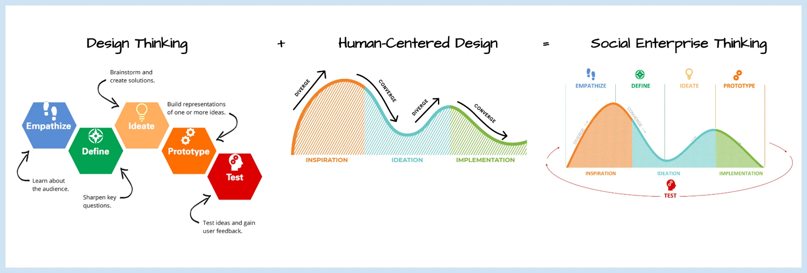
HCD process + Design Thinking

Slide 25
Design Thinking vs HCD
To make this more clear, any business can use Design Thinking to build a solution that is capable of making money.
For example, a company may use Design Thinking to create a video game or TV show for kids.
Applying Human-Centered Design on top of this will ensure that the show actually serves the needs of the people watching it.
https://blog.movingworlds.org/human-centered-design-vs-design-thinking-how-theyre-different-and-how-to-use-them-together-to-create-lasting-change/

Slide 26
Design Thinking vs HCD Process vs HCD
Human Centered Design
HCD Process
Design Thinking
HCD is a mindset.
HCD Process e Design Thinking are design methods

Slide 27

House of Cards by Netflix
Before starting the production of House of Card, by analysing their data sets carefully, Netflix noticed that there was a correlation between fans of the original BBC House of Cards TV show and fans of both Kevin Spacey and director David Fincher.
Netflix brought together these three elements in one show and, voila, instant cult classic.
https://ideadrop.co/examples-of-data-driven-innovation/

Slide 28

Nappies and beer, Walmart
Beer and baby nappies aren’t two things that you’d usually associate with each other. However, these two products have become infamous in data science circles because of their unique relationship.
In 1992, Karen Heath – an analyst at Teradata – discovered that men visiting Walmart were extremely likely to buy beer whenever they stopped in to buy babies nappies. By placing the two items near to each other in the outlet, she was able to increase sales of both items by a significant margin.
https://ideadrop.co/examples-of-data-driven-innovation/

Slide 29
Development methods for innovative products:
Agile, Scrum and Devops

Slide 30
Waterfall Development
Waterfall methodology is a linear project management approach, where stakeholder and customer requirements are gathered at the beginning of the project, and then a sequential project plan is created to accommodate those requirements.
The waterfall method is so named because each phase of the project cascades into the next, following steadily down like a waterfall.
It’s a thorough, structured methodology and one that’s been around for a long time, because it works. Some of the industries that regularly use the waterfall method include construction, IT and software development.
However, the term “waterfall” is usually used in a software context.

Slide 31
Agile
Agile is the ability to create and respond to change. It is a way of dealing with, and ultimately succeeding in, an uncertain and turbulent environment.
It’s really about thinking through how you can understand what’s going on in the environment that you’re in today, identify what uncertainty you’re facing, and figure out how you can adapt to that as you go along.
Agile software development is more than frameworks such as Scrum, Extreme Programming or Feature-Driven Development (FDD).
Agile software development is an umbrella term for a set of frameworks and practices based on the values and principles expressed in the Manifesto for Agile Software Development and the 12 Principles behind it.

Slide 32
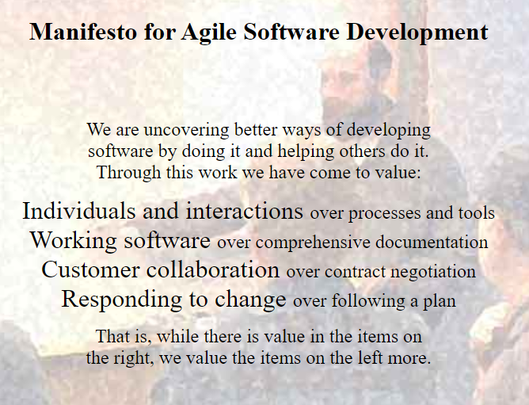
AGILE MANIFESTO and Principles
https://agilemanifesto.org/
https://www.agilealliance.org/agile101/12-principles-behind-the-agile-manifesto/

Slide 33
Agile
One thing that separates Agile from other approaches to software development is the focus on the people doing the work and how they work together.
Solutions evolve through collaboration between self-organizing cross-functional teams utilizing the appropriate practices for their context.
There’s a big focus in the Agile software development community on collaboration and the self-organizing team.
Agile is the best building method for HCD and Design thinking where continuous iterations are required

Slide 34
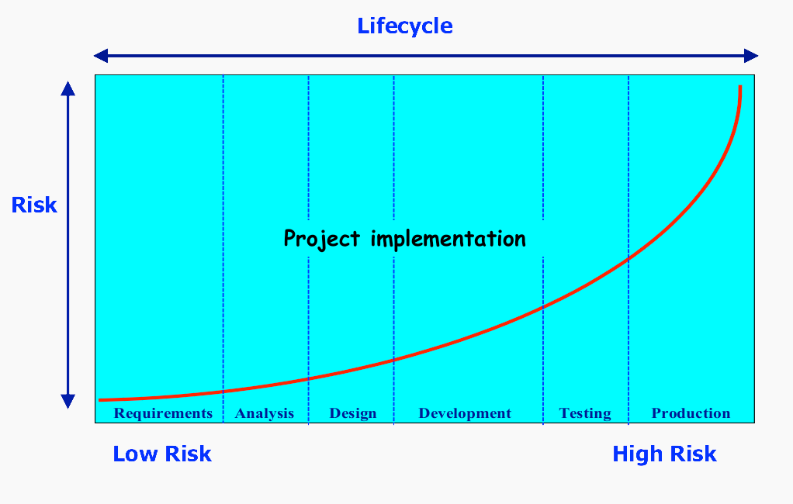
Risk in product development

Slide 35
Scrum
Scrum is an agile framework for developing, delivering, and sustaining complex products, with an initial emphasis on software development, although it has been used in other fields including research, sales, marketing and advanced technologies.
It is designed for teams of ten or fewer members, who break their work into goals that can be completed within timeboxed iterations, called sprints, no longer than one month and most commonly two weeks.
The Scrum Team track progress in 15-minute time-boxed daily meetings, called daily scrums. At the end of the sprint, the team holds sprint review, to demonstrate the work done, and sprint retrospective to improve continuously.

Slide 36
Scrum
A key principle of Scrum is the dual recognition that customers will change their minds about what they want or need (often called requirements volatility) and that there will be unpredictable challenges for which a predictive or planned approach is not suited.
As such, Scrum adopts an evidence-based empirical approach – accepting that the problem cannot be fully understood or defined up front, and instead focusing on how to maximize the team's ability to deliver quickly, to respond to emerging requirements, and to adapt to evolving technologies and changes in market conditions

Slide 37
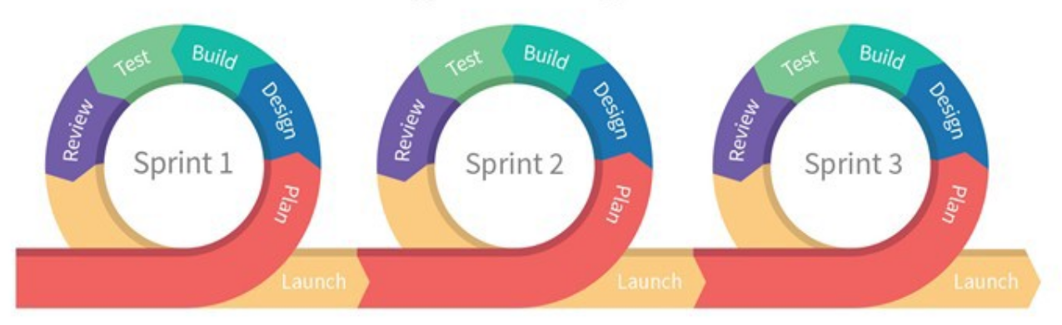
Scrum
A sprint is the basic unit of development in Scrum. The sprint is a timeboxed effort where the length is agreed and fixed in advance for each sprint and is normally between one week and one month, with two weeks being the most common.
Each sprint starts with a sprint planning event that establishes a sprint goal and the required product backlog items.
Each sprint ends with a sprint review and sprint retrospective, that reviews progress to show to stakeholders and identify lessons and improvements for the next sprints.

Slide 38
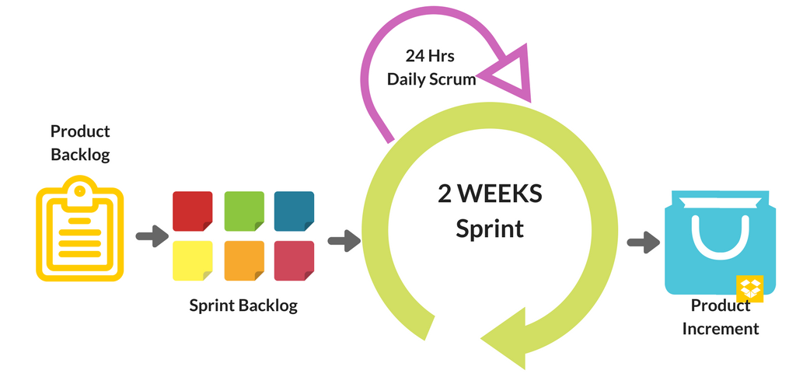
Scrum
There are three roles in the Scrum framework.
The product owner, representing the product's stakeholders and the voice of the customer, is responsible for delivering good business results.The product owner defines the product in customer-centric terms (typically user stories), adds them to the Product Backlog, and prioritizes them based on importance and dependencies.
The development team
The scrum master is not a traditional team lead or project manager but acts as a buffer between the team and any distracting influences. The scrum master ensures that the scrum framework is followed.
https://www.agilemarketingitalia.com/2018/05/09/scrum-agile-marketing/

